Slide 1
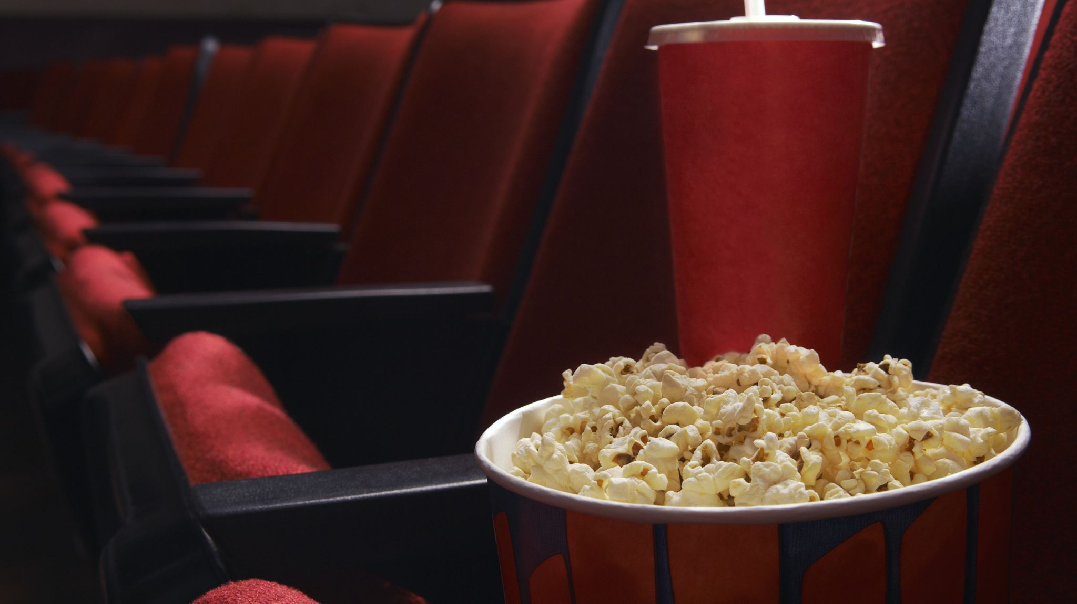
Movie ticket booking system
New and Improved
Yelena Martinez

Slide 2
Roadmap
Overview of new and improved product
Live demonstration
Functionality
User scenarios
Future plans

Slide 3
What is it? Who is it for?
The system is a user-friendly application for booking tickets to see a movie.
It can be used by anyone who has an interest in watching the latest movies.

Slide 4
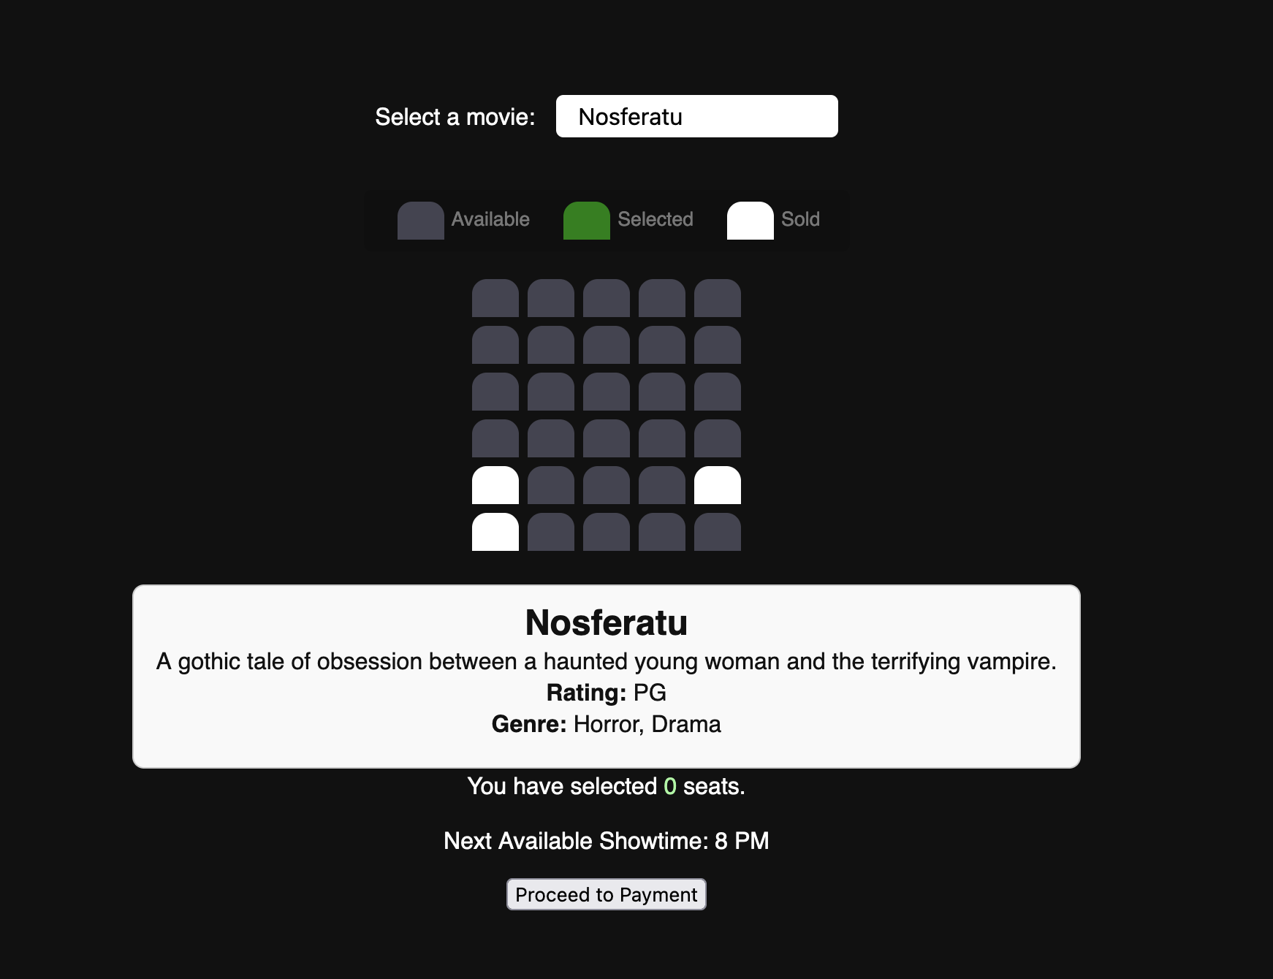
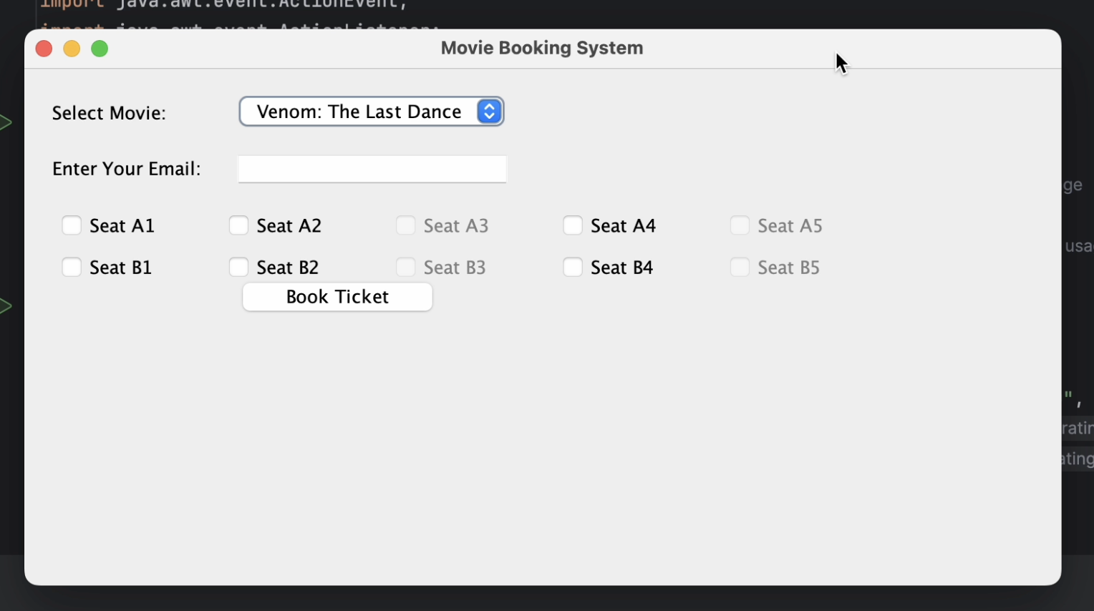
New and improved system compared to old system. The new system combines: HTML, PHP, and JS.
Implementation of PHP and SQL was introduced after the midterm project. I applied my knowledge from that class to this course’s final.

Slide 5
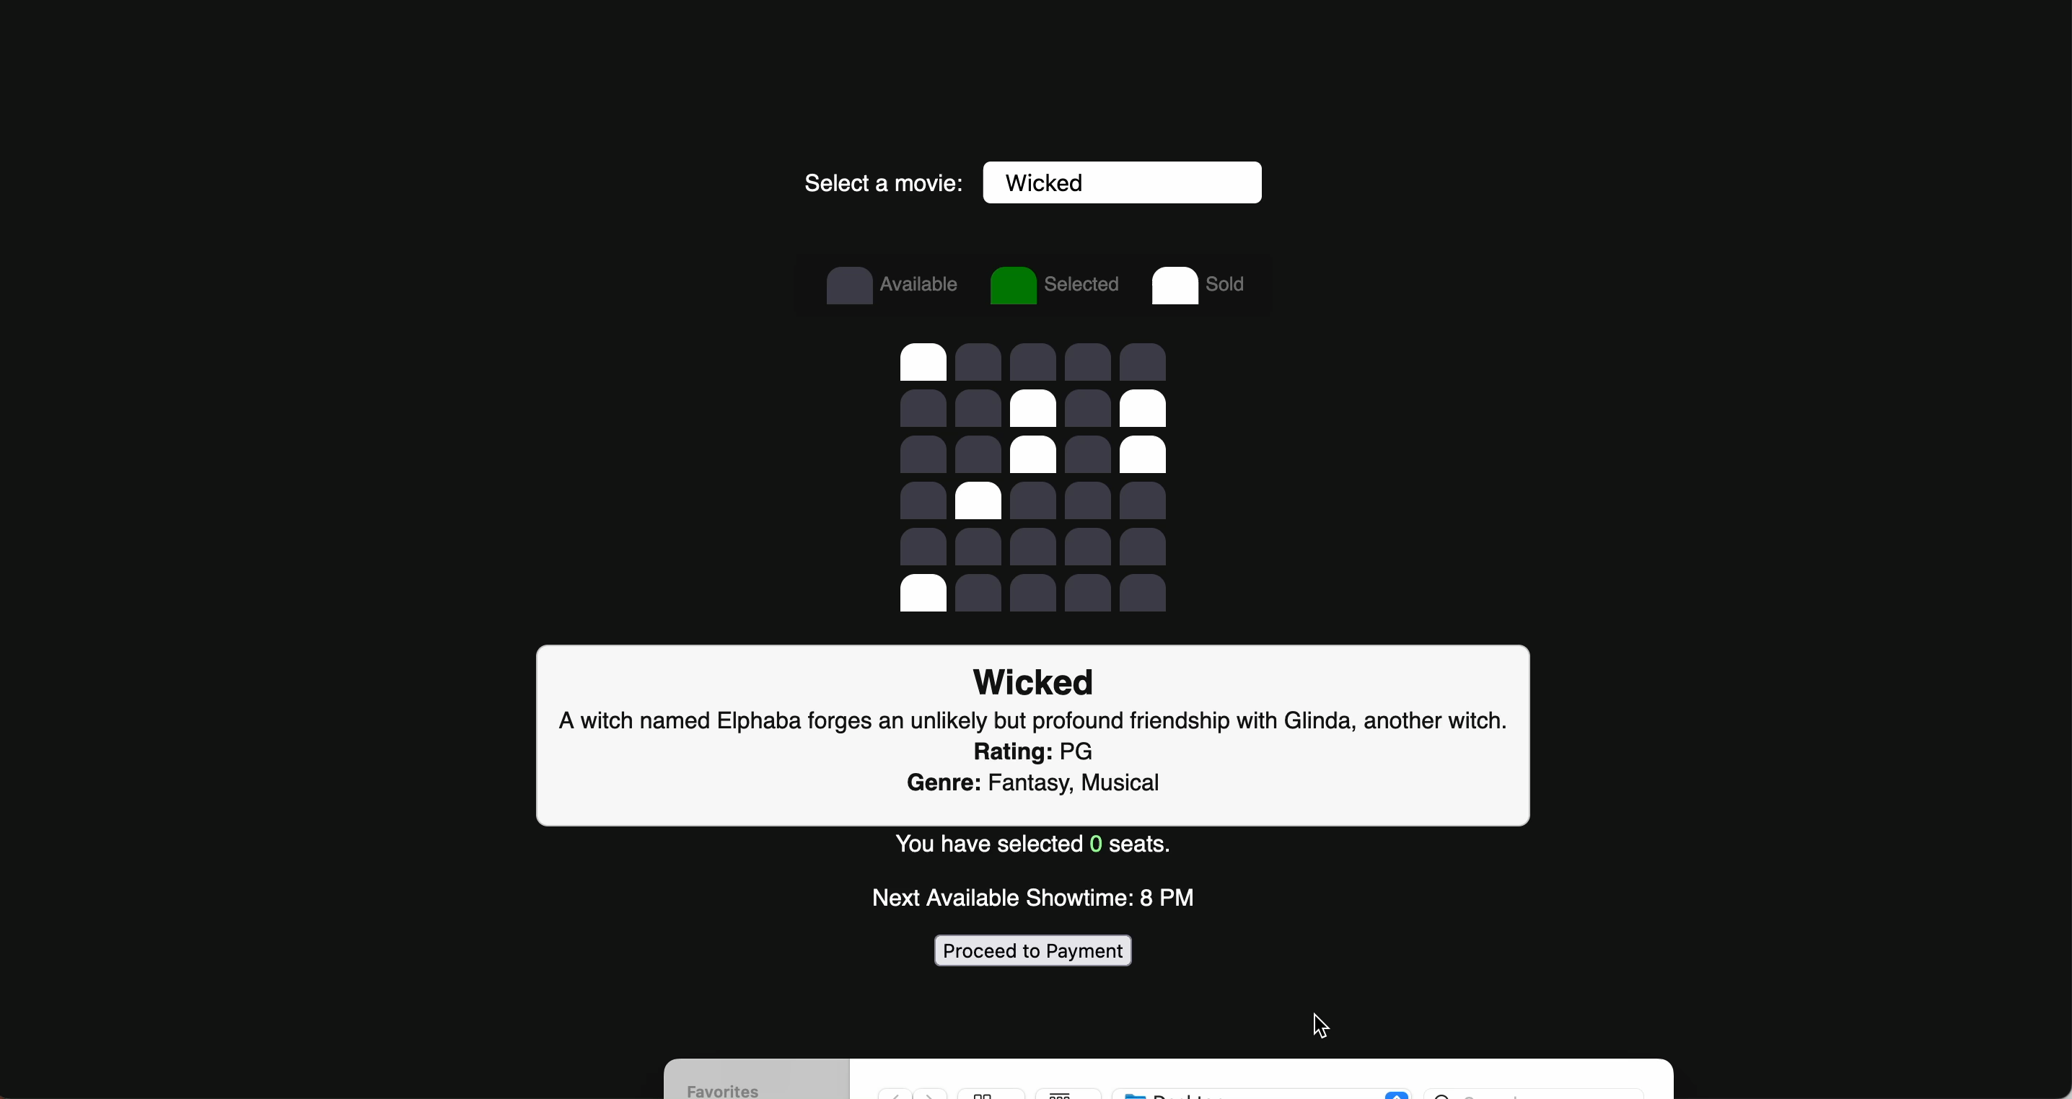
Live demonstration
Notes:
Backend

Slide 6
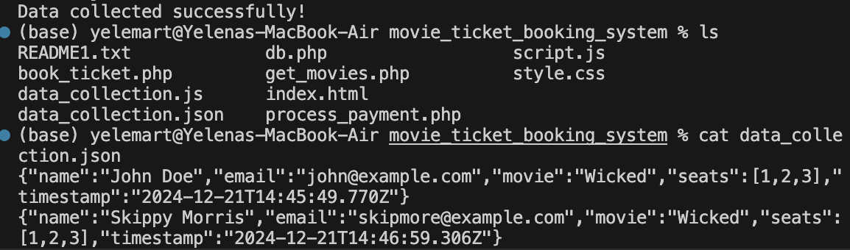
Data is then collected and extracted from a demo terminal, node.js and visual studio code
Notes:
frontend

Slide 7
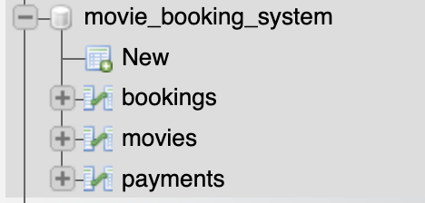
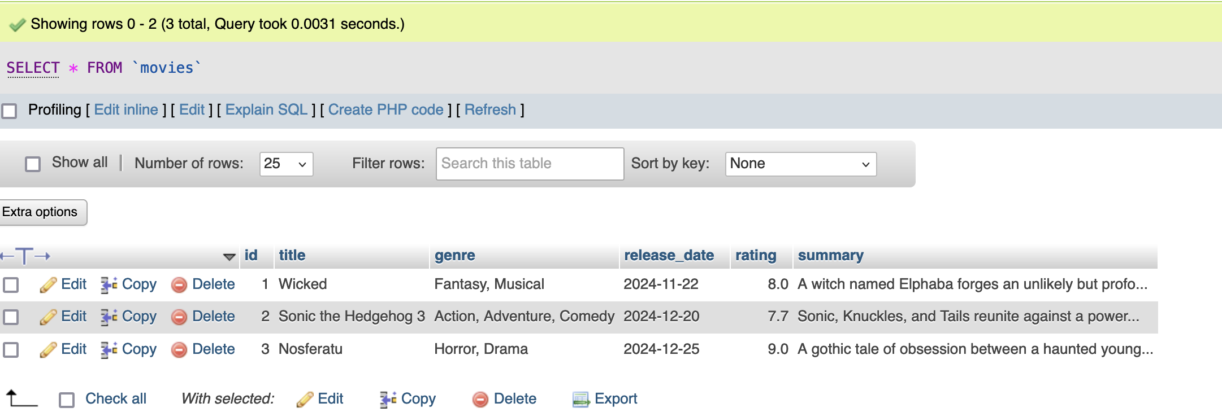
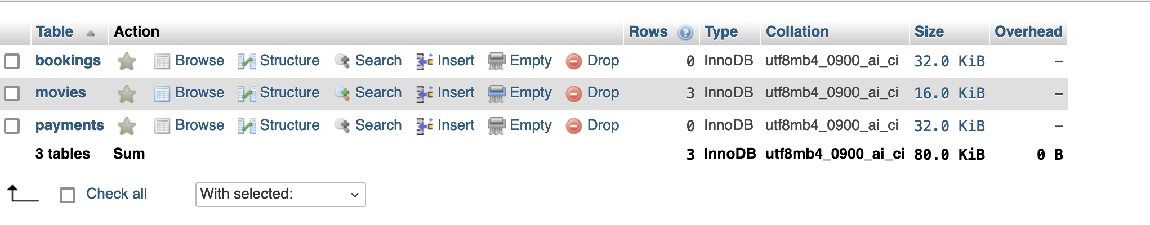
Database created to manage and store

Slide 8
Functionality and business goals
Movie Selection:
User can select movies and view movie details. This simplifies the selection process.
Seat Selection:
Users can choose available seat(s). This maximizes seat utilization
Booking:
Users can then book and choose a secure payment method. This builds trust in the booking process.
Confirmation:
Users will receive a confirmation popup with the info of the choices. It wil also send it to their email. This ensures reliability.

Slide 9

User Scenario
Scenario: A user wants to book a ticket for “Venom: The last dance”.
Steps:
User opens the application
They select the movie from the dropdown
They choose available seat(s) and enters their email
Confirms booking
Choose secure payment option
Receives a confirmation message
Main aspects:
Easy navigation, intuitive interface !

Slide 10
Future Plans from earlier.
A better layout
Enhanced payment processing options
Enhanced interactive seating
Enhanced structured data storage.
Each goal has been fulfilled!

Slide 11

Thank you!

